Slide 1

Lesson: 2.1
Introduction to Scripting

Slide 2
Lesson Objectives - 1
You should be able to...
1. | Create a new script in Unity
2. | Describe the default set of code in a Unity Script File
3. | Describe variable scope / Public vs. Private
4. | Use float, Int, string, and bool variables in a script
5. | Iterate code in a loop
6. | Check data in a conditional statement
7. | Collect user input
8. | Define and call a function

Slide 3
Lesson Objectives - 2
You should be able to...
9. | Describe data types.
10. | Utilize a string variable in a script
11. | Alter an object using a integer variable
12. | Use float, Int, string, and bool variables in a script
13. | Iterate code in a loop and see the results
14. | Check data in a conditional statement
15. | Collect user input
16. | Define and call a function

Slide 4
Key Terms - 1
Library | A pre-written set of code that is externally referenced.
Class | A named collection of functions.
Function | A named collection of statements that performs a specific task.
Statement | A line of code that represents a single command or action.
Curly Brackets | These symbols { }. The first is considered the opening brace, the next is the closing brace.
Debug | Methods for identifying and removing errors in code.
Console | A log or monitor of information to help debug code.
Syntax | The set of rules that defines the combinations of letters numbers and symbols that are considered to be correctly structured.

Slide 5
Key Terms - 2
Variable | A name that holds a certain type of data, which can change.
Data Type | The type of information stored in a Variable.
Variable Scope | The extent of when a variable can be referenced, accessed or modified.
Constant | A name that holds a certain type of data, that can not be changed.
String | A variable that represents text rather than numbers.
Integer | A whole number; a number that is not a fraction.
Float | A numeric variable with a fractional value.
Boolean | Two possible values, true or false.

Slide 6
Hook
Scripting

Slide 7
Are You Ready?
Ready to press some buttons?
Want to actually interact with your game?
Make your character actually move? This is where scripting comes into play.
With scripting you will add the actual interaction and mechanics to game objects to have them come to life.
This turns your static 3D objects into fully functional and programmable characters.
It’s totally worth the wait!

Slide 8
Instruct
C# Crash Course

Slide 9
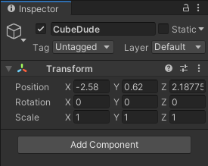
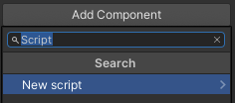
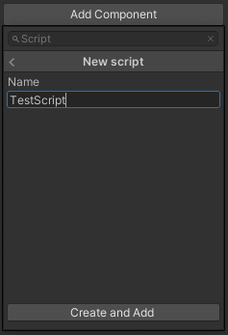
Let’s Script! Adding a Script to a GameObject - 1
In the Inspector click "Add Component" button at the bottom, and type in "Script."
1
2
Select any object in the game. For demonstration purposes we will use the CubeDude Character you created.
Select New Script.
Name your new script “TestScript” *No spaces or special characters are allowed, it will break the script.
Click Create and Add.
It might take a moment to show up in the Inspector, try hitting play.
3

Slide 10
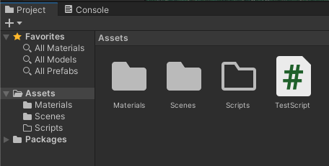
Let’s Script! Adding a Script to a GameObject - 2
This script is now a physical file in the Projects view.
Make a Scripts folder and move the script into it to keep your folders neat.
Double click on the 'TestScript' name, either in the Inspector or the Project View. This will open up the script in Visual Studio.
* Any IED or Text Editor will work, but we are using Visual Studio for our demo. This includes color coded text for development purposes. You may also want to require all C# files to automatically be opened with Visual Studio.

Slide 11
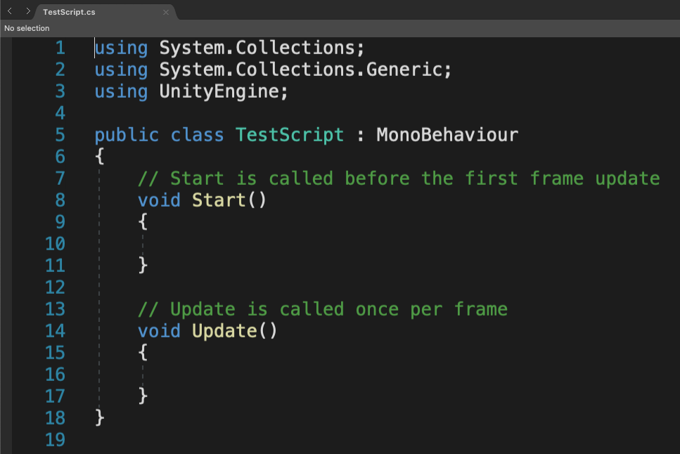
Default Script for Unity - 1
All Unity Script Files come preloaded to look like this. Let’s go over what this is...
Unity Libraries (don’t ever touch or delete these)
This Script as a Class!
(See the File name already there…?)
Start Function
(What to do before the game begins)
Update Function
(What to do during the game)

Slide 12

Default Script for Unity - 2
Don’t worry if this is a bit much…We will walk you through this slowly.
?
?
?
?
?

Slide 13
Brain Break
Now is a good time to check in with your team about their comfort level with code.
Go around and ask general questions about their previous experience with coding:
Do you have any experience with coding?
If No, does it intimidate you?
Have you ever used block coding like Scratch, or MakeCode, or Lego Mindstorms if yes , then try bolt if you don’t really like C#?
Are you excited about coding?
If so, which language?
How did you use it?
What is your comfort level with coding in general?
What about the last slide did you understand?
Getting a sense of where your peers and teammates are with coding will give you a better understanding of how quickly you will need to work through the next set of slides. Teammates with little to no coding experience may need extra time to absorb the information while experienced peers could use the refresher, but may move quicker through the slides.

Slide 14

What is Coding?
Coding, in simple terms, are just instructions. We use instructions to do things all the time. Like following a recipe to bake a cake, getting directions to the store, learning to use the controllers on your favorite game or even asking your parents to teach you something new. It all requires following a set of step by step actions in order to accomplish a task.
Coding is no different. It’s creating a set of instructions for the computer to follow. If you write the instructions in a way the computer can follow and understand you can teach it to do anything you want!

Slide 15
What is a Library?
Computers are like babies. They don’t really know anything and have to be explained even the smallest thing. Computers start knowing only the difference between on and off.
Fortunately for you, many other smart programmers out there have done the hard work of teaching computers to do amazing things. These rich set of instructions for computers are things like applications, Operating systems and drivers for hardware.
Imagine being asked to race a car, and the only thing your are given is a pile of scrap metal. You’d have to build your car from scratch before you can even get on the road let alone win the race. That alone is a tone of work! A library is like someone giving you an actual race car instead of that pile of scrap metal.
Libraries are sets of code that has already been written for you.
At the top of the default script are libraries your script needs to have to do some amazing things.
Unity Libraries

Slide 16
What is a Script Class?
On line 5 is the definition of your new script.
Public means it can be used anywhere in your game
Class refers to this script as a set of functions, meaning there can be more than one action and they are grouped together under a single name.
TestScript is actually the name you gave your script when you named it. This name has to match the name of the file you created in order to work. Giving your script a name also allows it to be referenced by that name in other scripts.
MonoBehaviour is the base class from which every Unity script derives. You can ignore that- just know you shouldn't change or remove that part.
Also note the Curly Brackets. All of your code must be placed between the open and closing curly brackets. They act as containers for your scripts

Slide 17
What is void Start?
Inside your class definition (after the first opening curly bracket) is a function called Start()
Void refers to the type of information you are expecting to be returned from your function. To start, we are not expecting anything back. Hence the word void, it means we are expecting nothing to be returned. ** it may seem odd that we start this line with what are expecting at the end. This is just how this particular language was written. It isn’t this way in other languages.
Start() is the name of a function that was defined in the Unity Library. It’s a function that will run just once, before your game begins. It’s good for setting up some rules about your game before you actually play it.
* Note that start is indented in. This is because it is inside your TestScript Class (after the first curly bracket, but before the last curly bracket). It’s good coding practice to indent code that belongs inside other functions.
** Notice more curly brackets!! The code you want to run just once has to be placed after the curly brackets on line 9, and before the curly bracket on line 11. Don’t worry, you can add more lines here.
All functions begin and end with curly brackets.

Slide 18
What is a function?
We started using the word function without a proper introduction. In coding, a function is a named set of instructions. If you had a robot and wanted to program it to get you ice cream from the freezer you’d first have to tell it where to turn and move to get to the freezer, and then open the door and find the ice cream etc.
But you don’t want to repeat that information every time you make this request. Instead you name the set of instructions and then ask the robot to follow them when you call that name.
Function - A named set of instructions.
Call or Run - Commanding that the function actions be carried out.
Defining the function doesn’t make it happen. A function will only be run when it is called to run.
Code that belongs to a function must be placed between theses curly brackets

Slide 19
Explore
Your Turn!

Slide 20
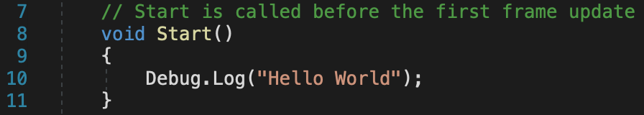

Test it out! - 1
Inside the Start Function, on line 10, add this:
This is a statement. It is a single action or command. Functions are collections of statements.
Save your file (command+S on Mac, or Control+S on a PC)
Then go back to Unity and Preview your game by pressing Play

Slide 21
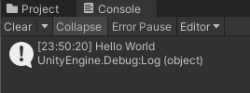
Test it out! - 2
Next to the Project Panel tab is another tab labeled Console. Click on this tab to open it.
If your script written and connected properly you will see this.
This is a way of testing if you script is working. Debug.Log() will output information to this console tab. In this case we output the string “Hello World”. Go ahead and experiment with your own sentence!

Slide 22
Watch the Syntax!
Syntax is the set of rules that defines how we are allowed to write the code. (Capitalization, Punctuation etc.)
This includes everything on this page and a whole lot more. If you don’t get the syntax correct the computer will not read the code properly and give an error. Below are all the syntax elements of the statement we just used.
Must be in the Start() function
Must have open and closed Parenthesis ( )
Must be between the Curly Brackets { }
Must end with a semicolon ;
Capitalization and Spelling Matters!
Text must be inside quotation marks. “ “

Slide 23
What did we do?
All functions are called with their name followed by parenthesis
Start() function happens once, before the game begins
Debug is a set of functions (a class) that help us solve issues with our code.
Log is one of those functions that outputs information into the console.
These were provided by the Unity Library
Must end with a semicolon ;
Debug is a class, Log is a function inside that class.
The dot (or period) is called dot notation and is used to help call the function inside the class
Information can be passed (or given) to a function by placing it in the parenthesis.

Slide 24

Watch Out for Common Errors!
Missing semicolon
Missing bracket in file :
Missing semicolon at end of file:
Class name doesn’t match file name (might have a space)
Variable or function name doesn’t match

Slide 25
Check for Understanding
Check-In

Slide 26
Check the Codes
Verify that everyone in your team succeeded with this set of code. Have them explain to you the difference between a statement, a function and a class. This will help them understand why the code is organized the way it is, and why sets of code are grouped together.
Here is another way to look at it what we covered:
A statement is a single command, like “Turn Left”
A function is a collections of statements, like “Directions to Tom’s House”
A Class is a group of functions, like this:
Directions to Tom’s House
Directions to Sally’s House
Directions to David’s House

Slide 27
Extension
Bonus Activity

Slide 28
Consoles
Try out different messages in the console. Write more than one Debug.Log message.
Maybe try passing numbers, and math equations.
What other things could you possibly need this function for? Have a discussion with you group how this could be used to build better games.
Not sure? Check this out...

Slide 29
Instruct - 2
Variables

Slide 30
Get Excited for: Variables!
The most valuable tool in coding is the variable. A variable stores information and allows you to track data across your game. This also allows you to manipulate and variate parts of your game on the fly instead of manually making changes to various objects. Mastering variables allows you make your game exciting and less predictable.

Slide 31
Intro to Variables
Variables are names used to store information or data.
If we wanted to store the name of a player, we could create a variable called “PlayerName” and assign it to hold any name we want, like “Luigi”.
One of the useful functions of a variable is that the information can be retrieved for later use, or changed depending on what happens in our game. The most common variable used in a game is “Score” which often starts at zero, and increases as our player scores points. Score is simply the name of the information we are storing during the game.
Some variables hold information that never changes. An example would be storing your birthday. We could use that information to calculate your age, but the birthday itself never changes. This information is stored as a Constant Variable, and declaring it as such informs the program that it must remain static, even if other code attempts to change it.

Slide 32
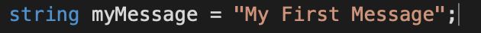
Try It: Variables - 1
Creating a variable in C# requires some syntax, here it is:
Start with the type of data being stored.
Then provide the name of the variable.
*This must start with a lowercase letter and cannot contain spaces or special characters.
We then use
the equal sign “=”.
This is an assignment operator.
Next is the data we wish to store.
The type of data you provide here must match the type you declared at the beginning of this statement.
All C# statements must end with a semicolon “;”

Slide 33
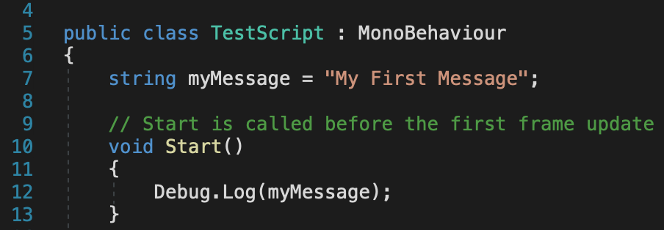
Try It: Variables - 2
Let’s use this in our TestScript. Start by declaring this variable on line 7, inside the TestScript class,
but before the void Start() function.
Now use that variable in our Debug.Log() statement by replacing “Hello World” with the name of our variable. Anywhere inside the Start() function.

Slide 34
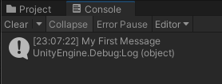
Try It: Variables - 3
Save your script, then return to Unity and press play.
You should now see “My First Message” in the console instead of “Hello World”.
We retrieved the information stored in the variable by simply tying it’s name in our Debug.Log() statement. There are many other places you can utilize these variables, but retrieving the stored information is as easy as simply typing its name.

Slide 35

Variables: Variable Scope
Unity automatically assumes that any variables we create are private, meaning they can only be accessed by the script itself. We can do this manually as well:
But you can also declare variables as public, which allows them to be used anywhere:
Change your variable by adding the word “public” to the beginning, then return to Unity and press play.
private string myMessage = "Goodbye, Universe!";
public string myMessage = "Goodbye, Universe!";
In the Inspector Tab of our GameObject under the Script component you will now see your variable, and can even edit it!

Slide 36
Variables: Variable Scope
One special thing about Unity is the information stored in a variable in the Inspector Tab overrules the information you assigned in your script.
This means if you change “My First Message” in Unity, it will remain that way even if you change it in your script. Unity values overrule values assigned in the script.
*Note: Values assigned while the game is running in preview mode are temporary and are reset when you stop the preview.
Try this by changing the value of MyMessage in the Unity Inspector to “My Unity Message”. Then return to your script and assign myMessage to “Goodbye”.
public string myMessage = "Goodbye";
Press play and see what appears in the console.

Slide 37
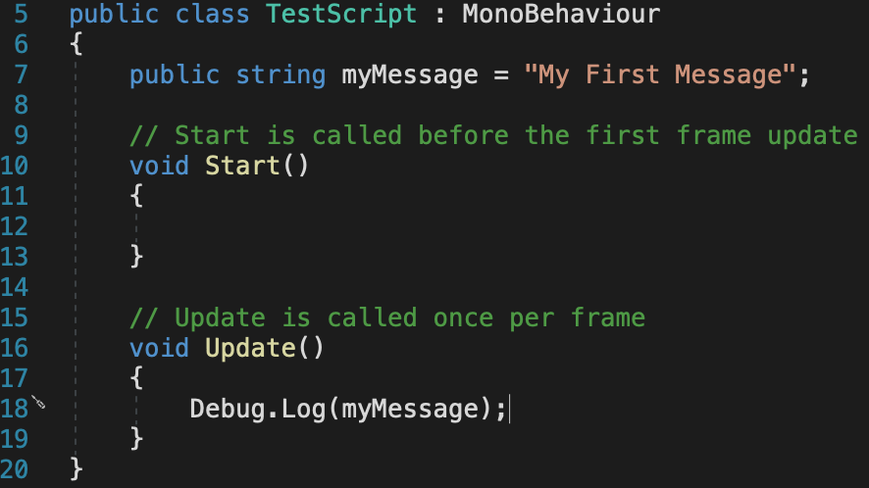
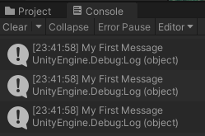
Start() vs. Update()
Another thing we need to remember is that code placed inside the Start() function will run just one time. But code placed inside the Update() function will run repeatedly. Try this by moving your Debug.Log(myMessage) statement from Start() to Update(), save the script return to Unity and restart your preview.
You should now see the Console repeating the Debug.Log() message. You can also change the variable in the Inspector and see the changes as you type!

Slide 38
Variables Data Types: String
Data types let your program know what kind of data your variable is using. The script can utilize the data in different ways if they are declared properly. Improperly declared variables can result in errors and your code not working properly.
Strings are any set of letters, numbers or special characters that are placed inside of quotation marks. This information can be recalled and printed on the screen, but cannot be used mathematically. It is limited to simply storing sentences.
public string myMessage = "Goodbye";
Declare a string by typing “string” before the variable name
You must assign the data using quotation marks.

Slide 39
Variables Data Types: Integers
Integers are whole numbers and can be used mathematically. “Score” is a good example of an integer variable because you typically score full points in game, not partial points, and when a player scores a point you use math to add to the score.
public int Score = 10;
Declare a Integer by typing “int” before the variable name.
Do not use any quotation marks.
Floats are decimals numbers and can be used just like integers except they can represent partial numbers in a decimal format.
Booleans are variables that represent True or False. Or as On and Off. This is good for use

Slide 40
Variables: INTEGERS example
Programming requires a lot of math. Luckily, we can make Unity do it for us.
Add another Debug.Log to the Update(), and add in whatever mathematical statement you like.
Without quotation marks, the console prints the results of two numbers added together - this is because Unity interprets these numbers as integers instead of strings.
You can also add in a string to the same line, which can be useful for printing more legible statements.
void Update() { Debug.Log(5+2); }
Debug.Log("Answer: " + 5+2);

Slide 41
Variables: INTEGERS - 2
Experiment with assigning integers.
Create a public integer so we can see our variable change while the game is playing.
public int myInteger = 5; void Update() { Debug.Log("Double: " + myInteger *2); }
Use Operators for math symbols:
“ + ” for addition
“ - ” for subtraction
“ * “ for multiplication
“ / “ for division
*Note: If you attempt to divide an integer it will round the result if the division is not a whole number.

Slide 42
Variables Data Types: Floats
Floats are decimals numbers and can be used just like integers except they can represent partial numbers in a decimal format. An example of a variable that would use a float is “Time”. You can represent how much time a player has left to complete a level and use partial seconds as a float variable.
public float Score = 10f;
Declare a Float by typing “float” before the variable name.
You must add an “F” to the end of the number.
Do not use any quotation marks.

Slide 43
Variables: Floats - 2
Experiment with assigning Floats.
Create a public float so we can see our variable change while the game is playing.
public float myFloat = 5.5f; void Update() { Debug.Log("Double: " + myFloat / 2); }

Slide 44
Variables Data Types: Boolean
Booleans are variables that represent True or False. You could also use them as On or Off, or Yes and No. Unity represents booleans as a check mark next to the variable. Since Booleans have actual numerical values of either 0 or 1 they can be used as a condition and acted upon if True or False. A good example would be checking whether a player has a key. If this is True then they can open a door.
Using a string as “True” or “False” would not work in the door example because strings only represent letters and symbols and therefore do not have numeric values.
public bool hasKey = True;
Declare a boolean by typing “bool” before the variable name.
You can type True or False to represent its value
Do not use any quotation marks.

Slide 45
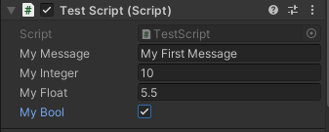
Variables Data Types: Boolean
A variable that can only have two possible outcomes, true or false.
One last variable type! Add this to your script:
public bool myBool;
In the Inspector we can see that this boolean type creates a little check mark. Bool can be either 'true' or 'false.’

Slide 46
Variables Data Types: Vector3
The Vector3 variable represents 3 numbers. Often used in games and 3D modeling this variable often represents the X, Y and Z axis in this form: (0,0,0)
public Vector3 move;

Slide 47
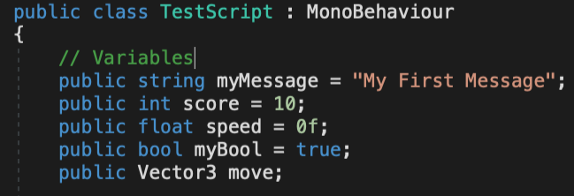
Variable Declarations
Now that you know what variables are, let’s put some in our code so we can work with them in the next chapter.
Variables are always declared at the beginning of a program. This helps us organize the code and keeps the intention of the code are the forefront of the program.
Create the variables as shown.

Slide 48
Key Terms - Review
It’s important to review key terms from the lesson.
Try and define what these terms mean and describe how you used them!
Variable
Data Type
Variable Scope
Constant
String
Integer
Float
Boolean
Library
Class
Function
Statement
Curly Brackets
Debug
Console
Syntax

